Slide 1
Camera – imu calibration
Mobile Robotics
~ Bollimuntha Shreya
Md. Faizal Karim

Slide 2

Introduction
Camera-IMU Calibration estimates the spatial and temporal parameters of a camera system with respect to an intrinsically calibrated IMU.
Precision in aligning these sensors is crucial for enhancing the reliability and accuracy of data used in navigation, object tracking, and spatial awareness applications.
This calibration is fundamental in enabling systems for autonomous vehicles, drone navigation, human-machine interaction, and more.

Slide 3
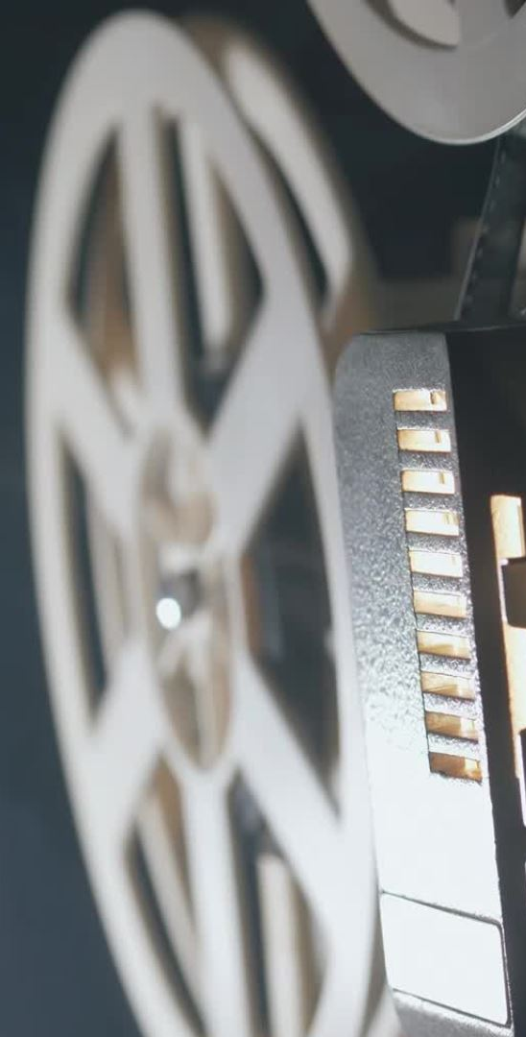
overview
Camera vs IMU
Simulations
Hardware Implementation

Slide 4
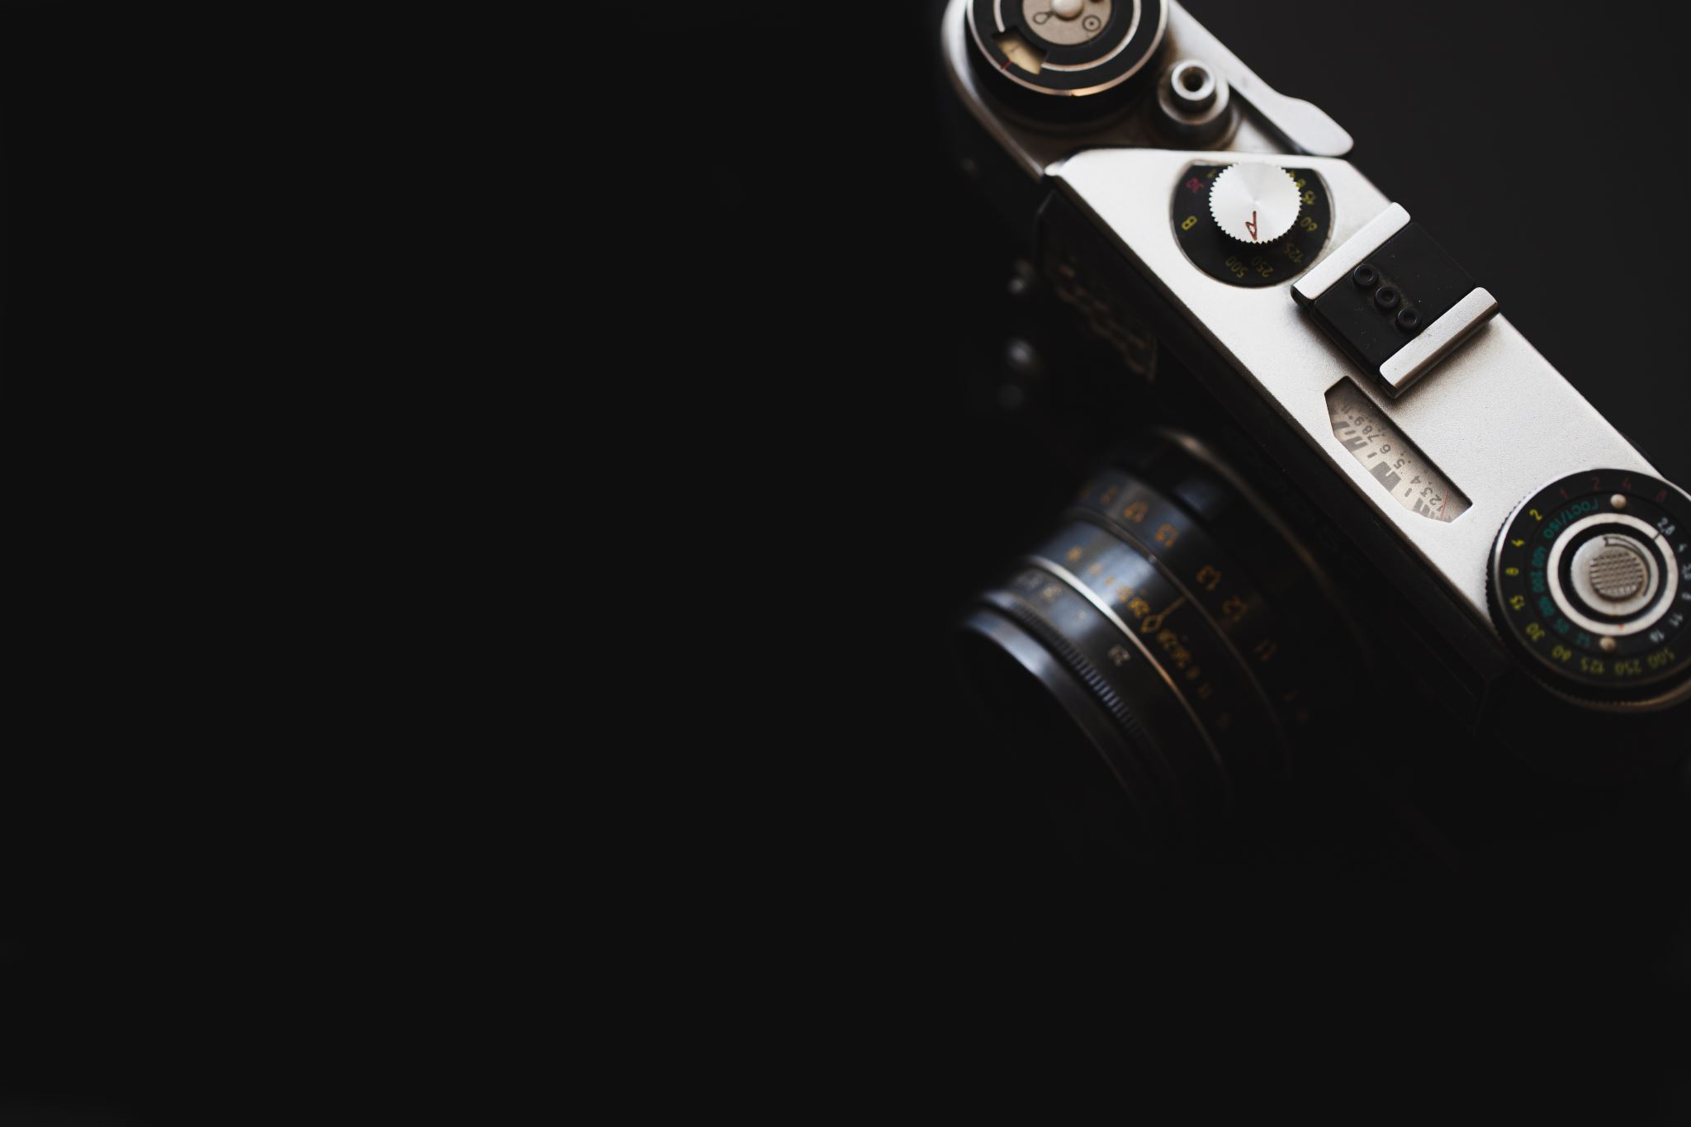
Camera - Imu

Slide 5
methodology
There are three steps involved :
Camera calibration
IMU sensor data
Camera – IMU calibration

Slide 6
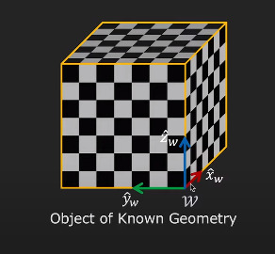
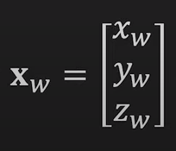
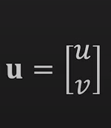
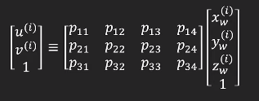
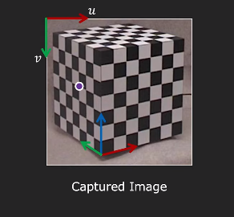

camera calibration
Camera Calibration involves estimating the projection matrix.
Capture an image of known geometry
Identify correspondences between 3D scene points and image points
For each corresponding point i in scene and image
Rearrange the terms
Solve for p

Slide 7
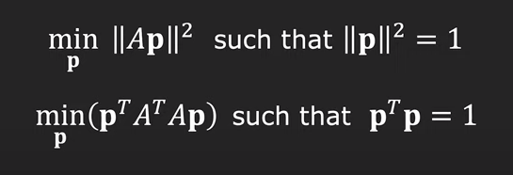
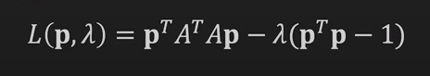
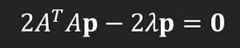

CONSTRAINED LEAST SQUARES SOLUTION
Least Squares Solution for P
Loss Function:
Take the derivative of the loss function with respect to P and set it equal to zero
Solve the eigenvalue problem to find the eigenvector corresponding to the smallest eigenvalue of A transpose
Eigenvector p with smallest eigenvalue λ of matrix A^T.A minimizes the loss function L(p)
Rearrange the elements of P to obtain the projection matrix P

Slide 8
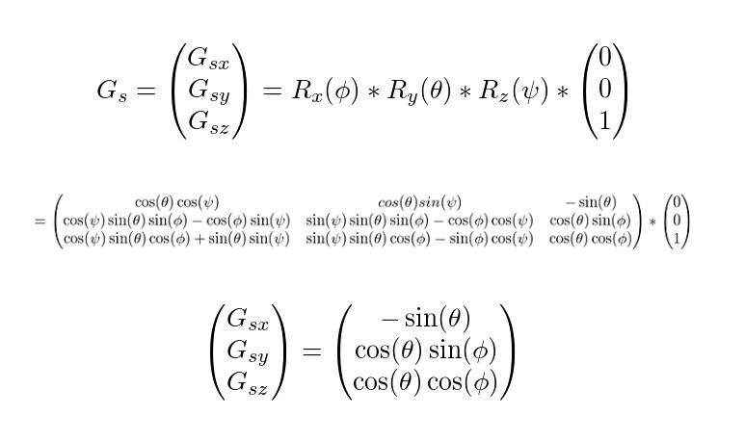
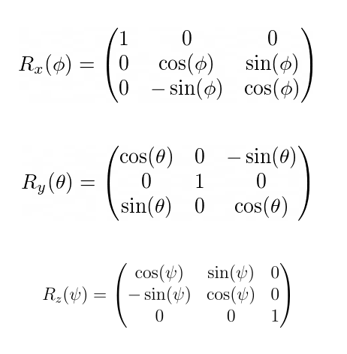
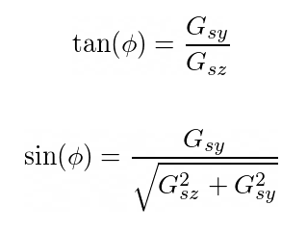
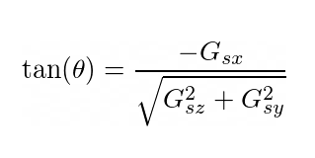
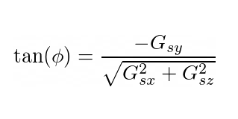
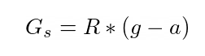
IMU Sensor
An IMU Sensor contains a gyroscope, magnetometer, and an accelerometer.
It gives us the pose of a mobile robot. (x,y,z,r,p,y).
Estimating roll and pitch from accelerometer
Roll is rotation about x axis
Pitch is rotation about y axis

Slide 9
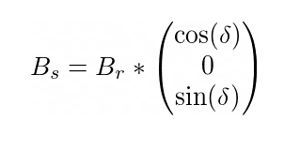
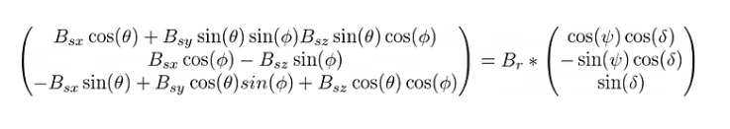
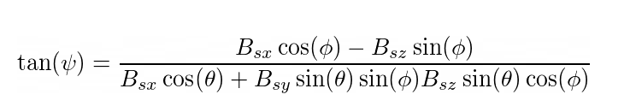
Estimate yaw using magnetometer

Slide 10
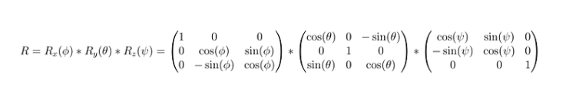
Rotation Matrix using IMU Sensor
The acceleration values stacked up give us the rotation matrix

Slide 11
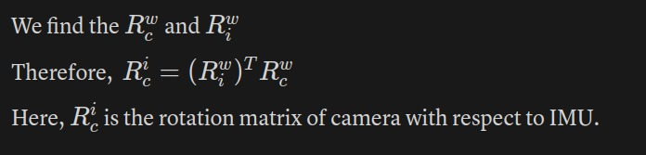
Camera – IMU Calibration

Slide 12
Simulations

Slide 13
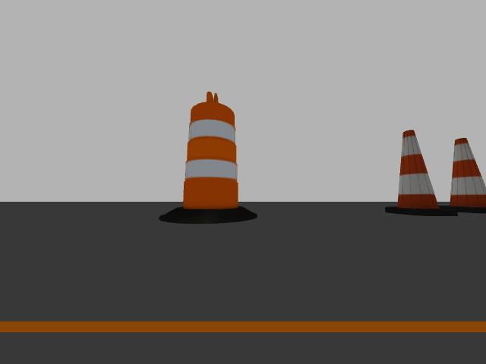
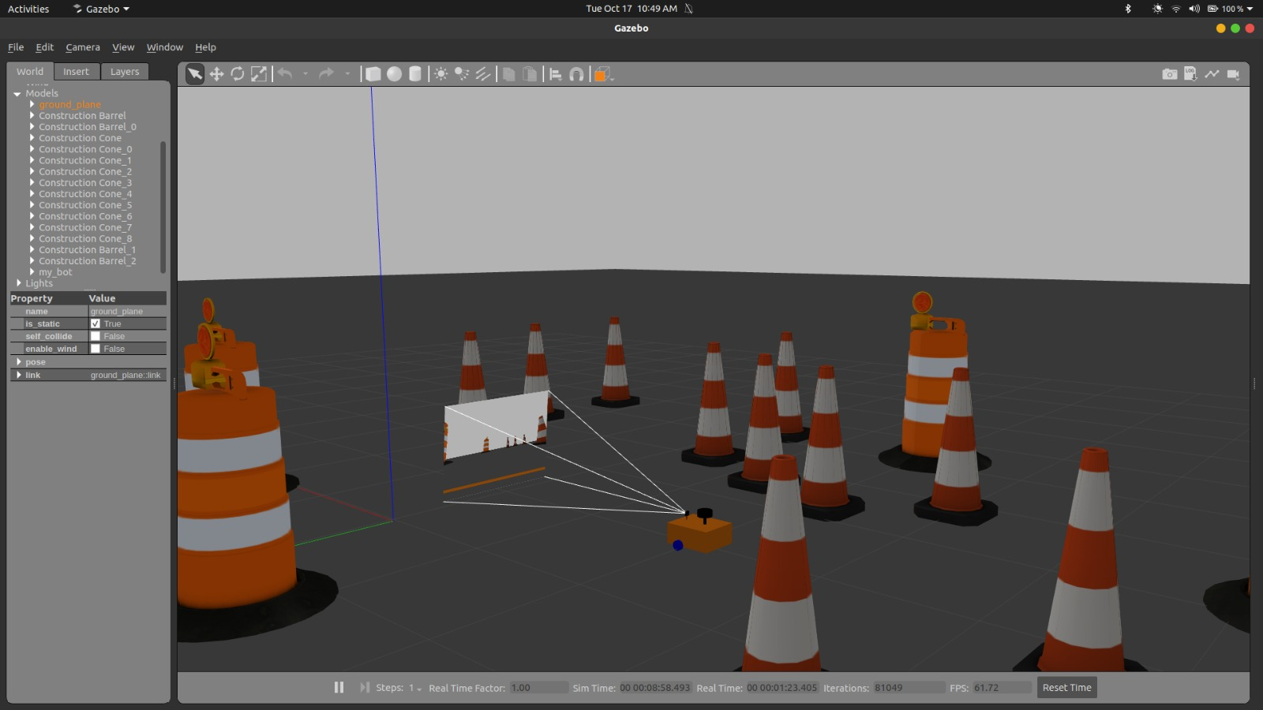
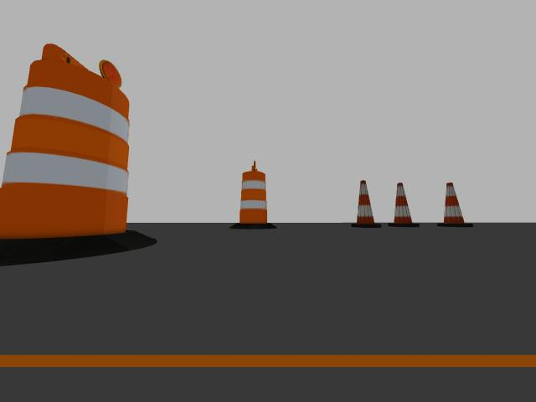
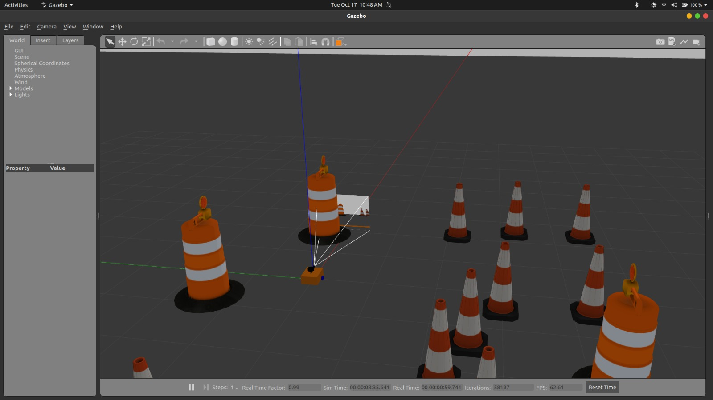
Gazebo environment

Slide 14
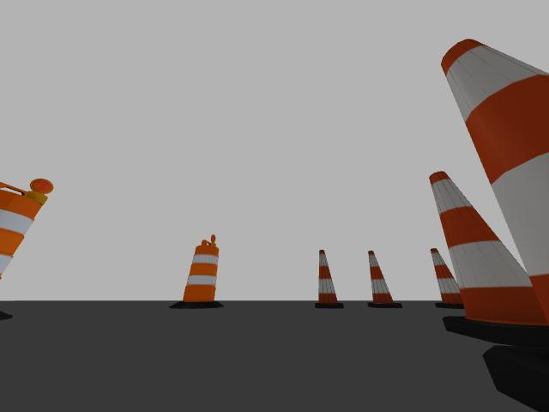
Rotation Matrix (Camera wrt World using camera calibration): [0.8137 -0.469 0.342]
[0.469 0.8137 0.3420]
[-0.342 0.342 0.876]
Rotation Matrix (IMU wrt World from IMU Data): [0.8137 -0.469 0.342]
[0.469 0.8137 0.3420]
[-0.342 0.342 0.876]
Rotation Matrix (IMU wrt Camera): [1 0 1]
[0 1 0]
[0 0 1] True angles: [60, 35, 0]
Predicted angles: [59.997, 34.997, 0.002]
SIMULATION RESULTS

Slide 15
Hardware implementation

Slide 16
Hardware components
INTEL REALSENSE DEPTH CAMERA D455
CHECKERED BOARD

Slide 17
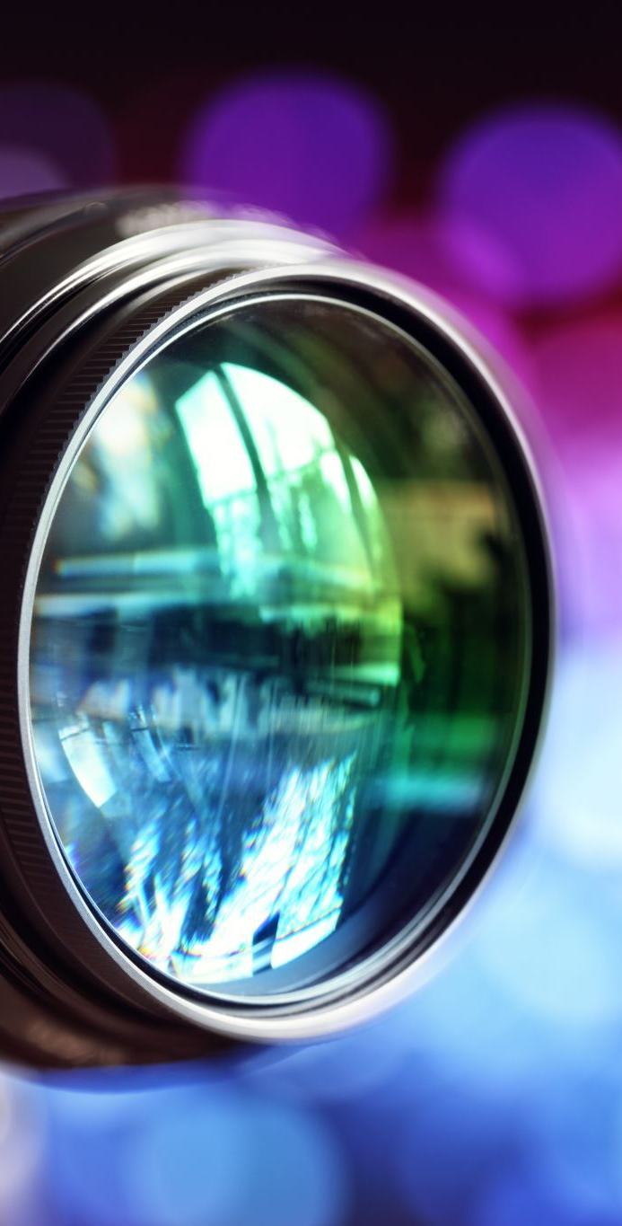
INTEL REALSENSE DEPTH CAMERA D455
Depth Sensing: The D455 camera is equipped with stereo depth sensors that allow for accurate depth perception and 3D imaging.
Depth Resolution: Capable of capturing high-resolution depth data up to 1280x720 pixels.
Range: Offers an extended range for depth sensing, up to approximately 10 meters (33 feet).
Field of View (FoV): Provides a wide FoV, approximately 91.2 degrees horizontally, 65.5 degrees vertically, and 100.6 degrees diagonally.
RGB (Color) Camera: Integrated RGB camera provides high-definition (HD) color images (up to 1920x1080 pixels) for additional visual context.
Depth Accuracy: Capable of delivering accurate depth data for various applications such as 3D scanning, object recognition, and depth-based analytics.
Stereo-Based Technology: Utilizes stereo vision technology to create 3D depth maps by comparing images from two distinct cameras.
IMU: the camera integrates an IMU to allow your application to refine its depth awareness in any situation where the camera moves. This allows improved environmental awareness for robotics and drones.

Slide 18
Ros
Command to start realsense D455
ros2 launch realsense2_camera rs_launch.py enable_gyro:=true enable_accel:=true unite_imu_method:=2-linear-interpolation rgb_camera.profile:=640x480x30
To start capturing image as well as IMU data:
ros2 run camera imu_node
To listen to the camera topic:
ros2 topic echo /camera/color/image_raw
To listen to the IMU data:
For accelerometer:
ros2 topic echo /camera/accel/sample
For gyroscope:
ros2 topic echo /camera/gyro/sample
To get information about camera:
ros2 topic echo /camera/color/camera_info

Slide 19
Results

Slide 20
Camera intrinsics (K)
Predicted Camera Matrix:
[381.654 0. 327.658]
[ 0. 382.267 243.633]
[ 0. 0. 1. ]
True Camera Matrix:
[378.46 0. 322.570]
[ 0. 378.047 242.000]
[ 0. 0. 1. ]]
Error: 6.286355867076903

Slide 21
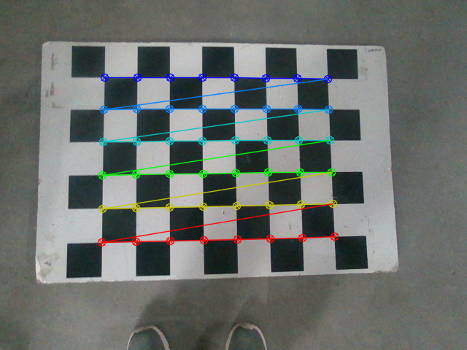
Rotation Matrix (Camera wrt World using camera calibration): [[ 0.997 0.018 -0.064] [-0.0139 0.997 0.062] [ 0.0654 -0.061 0.995]
Rotation Matrix (IMU wrt World from IMU Data): [ 0.996 -0.025 -0.074] [ 0.025 0.999 0. ] [ 0.074 -0.002 0.997]
Rotation Matrix (IMU wrt Camera): [ 0.999 0.038 0.011] [-0.039 0.997 0.062] [-0.009 -0.062 0.997]
Error: 0.0012386
True angles: [1.466, 355.715, 0]
Predicted angles: [358.964, 356.3019, 356.399]
IMAGE 1

Slide 22
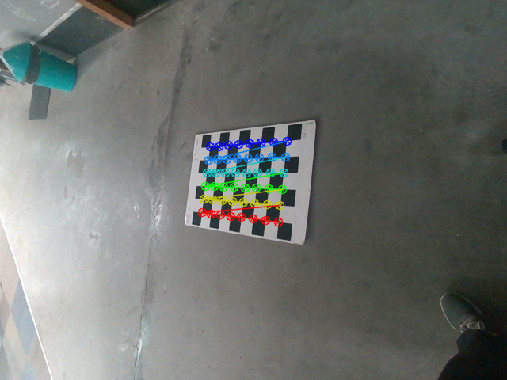
IMAGE 2
Rotation Matrix (Camera wrt World using camera calibration): [ 0.781 -0.104 0.614] [ 0.041 0.992 0.116] [-0.622 -0.066 0.780]
Rotation Matrix (IMU wrt World from IMU Data): [ 0.789 -0.032 0.612] [ 0.041 0.999 0. ] [-0.612 0.025 0.790]
Rotation Matrix (IMU wrt Camera): [[ 9.99e-01 -1.402e-03 1.282e-02] [-9.95e-05 9.932e-01 1.163e-01] [-1.290e-02 -1.1631e-01 9.931e-01]]
Error: 0.003053
True angles: [2.359, 37.776, 0]
Predicted angles: [7.626, 37.931, 351.487]

Slide 23
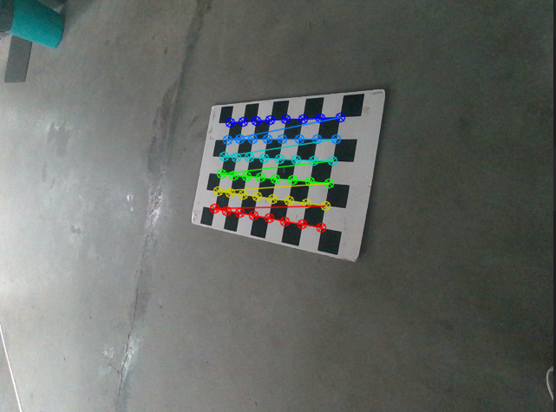
IMAGE 3
Rotation Matrix (Camera wrt World using camera calibration): [ 0.794 -0.169 0.583]
[ 0.123 0.985 0.118]
[-0.594 -0.022 0.803]
Rotation Matrix (IMU wrt World from IMU Data): [ 0.809 -0.094 0.579]
[ 0.115 0.993 0. ]
[-0.575 0.066 0.815]
Rotation Matrix (IMU wrt Camera): [ 0.999 -0.010 0.023]
[ 0.008 0.993 0.116]
[-0.024 -0.116 0.992]
Error: 0.0030538
True angles: [2.359, 37.776, 0]
Predicted angles: [7.626, 37.931, 351.487]

Slide 24
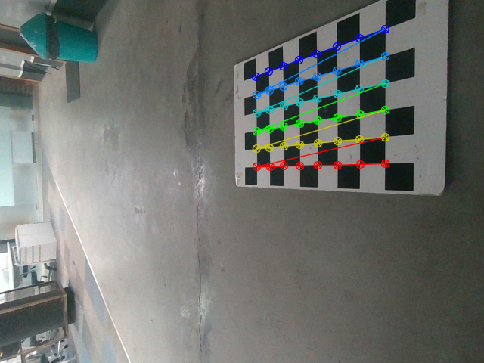
IMAGE 4
Rotation Matrix (Camera wrt World using camera calibration): [ 0.667 0.015 0.744] [ 0.025 0.998 -0.043] [-0.744 0.048 0.665]
Rotation Matrix (IMU wrt World from IMU Data): [ 0.638 0.028 0.768] [-0.045 0.998 0. ] [-0.767 -0.034 0.639]
Rotation Matrix (IMU wrt Camera): [ 0.996 -0.075 -0.033] [ 0.070 0.996 -0.045 ] [ 0.036 0.042 0.998 ]
Error: 0.0018425
True angles: [357.404, 50.237, 0]
Predicted angles: [358.685, 48.1417, 3.737]

Slide 25
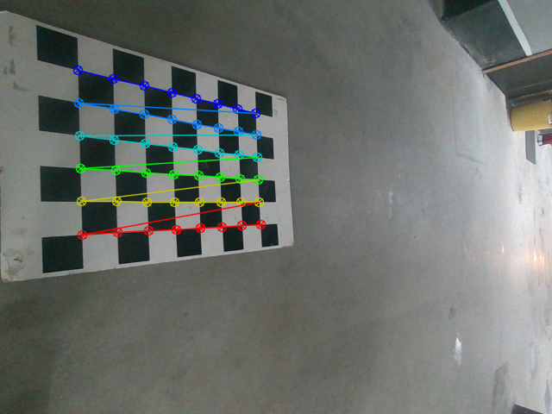
Rotation Matrix (Camera wrt World using camera calibration): [ 0.716 0.045 -0.695] [-0.014 0.998 0.050] [ 0.697 -0.026 0.716]
Rotation Matrix (IMU wrt World from IMU Data): [ 0.571 -0.020 -0.820] [ 0.035 0.999 0. ] [ 0.819 -0.029 0.572]
Rotation Matrix (IMU wrt Camera): [ 0.980 0.040 0.191] [-0.049 0.997 0.043] [-0.189 -0.052 0.980]
Error: 0.0090809
True angles: [2.031, 304.900, 0]
Predicted angles: [356.357, 315.9100, 355.962]
IMAGE 5

Slide 26
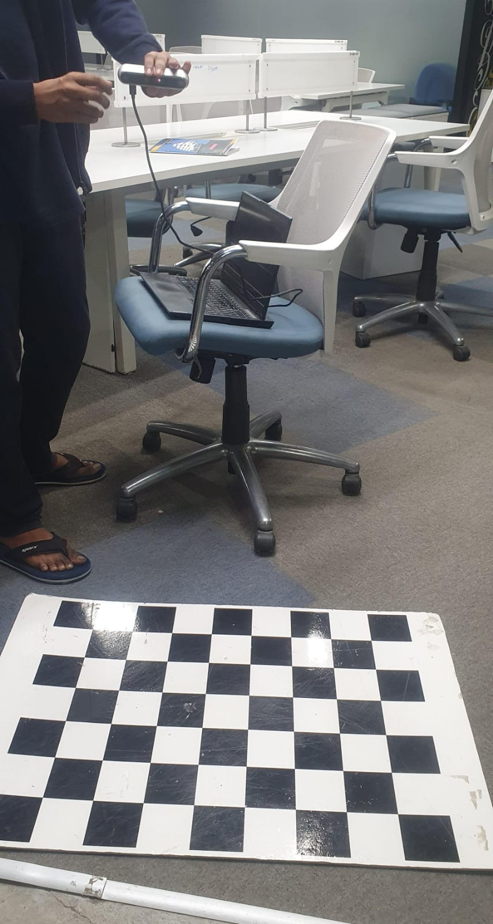
HARDWARE SETUP

Slide 27
INFERENCES
We observe that the rotation matrices of the camera wrt to the imu is nearly identity.
The Camera and IMU of the D455 are said to be calibrated.
There is improved spatial accuracy.
Improved alignment between camera and IMU resulting in more precise depth perception and motion tracking.

Slide 28
FUTURE WORK
The data from the gyroscope and the magnetometer can be included to improve the accuracy of the calibration.
Fine tune calibration techniques such as:
Machine Learning Algorithms
Kalman Filters
Extend our calibration approach to dynamic scenarios such that camera and imu are in motion.

Slide 29
Thank you !!

